Slide 1

Presentation on Kickstarter Crowdfunding
Presented By:- Group 1
Aman Agarwal
Shaik Mohammed Zaid
Jwalith Ulchala
Aditya Kumar
Tajammul Biyabani Mohammed
Rutuja Dnyaneshwar Navale
Pratiksha Mali

Slide 2
What is Crowdfunding?
Crowdfunding is the practice of funding a project or venture by raising money from a large number of people.
In Crowdfunding, with the help of projects along with creator list, location List and category List, dashboard is created using Excel, Power BI and Tableau Public.

Slide 3
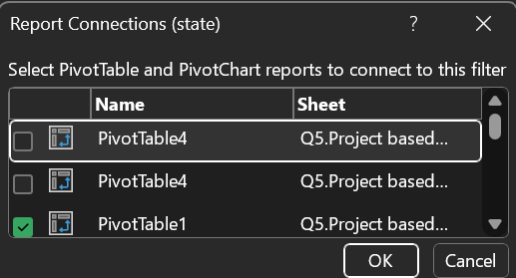
Challenges while Creating Dashboard in Excel
It cannot handle large datasets.
Slicers in excel are not directly connected to a chart, have to connect it using report connections to the pivot table used to create a chart.
The Key Performance indicator in excel is not connected to multiple slicers because referencing is used in excel
It takes lot of time to built interactive dashboard.

Slide 4
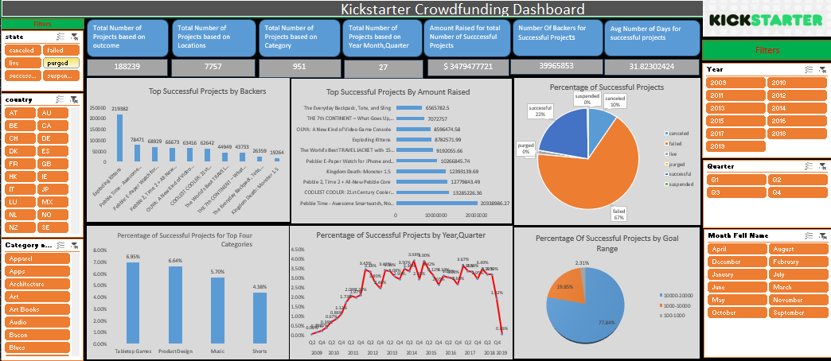
How did we encounter those challenges in excel dashboard
To manage the issue related to speed, better add the data sets in power pivot and make calculated columns as it consumers very less space.
It is always advisable to name a pivot table so while connecting charts with slicers , you can easily check them.
Since it is not possible to connect all slicers with a KPI, as we are using referencing so better create multiple KPI’s, one KPI for one slicer.
Dashboard

Slide 5

Challenges while creating report in Power BI
Since Power BI is one of the best tool for Visualizations but still we faced little challenges while creating Report on Power BI.
It is quite difficult to understand the use of CALCULATE() function in DAX.
It is quite confusing when to use Measures or calculated columns.
In DAX, there are many functions, it is quite difficult to remember all in built functions.

Slide 6
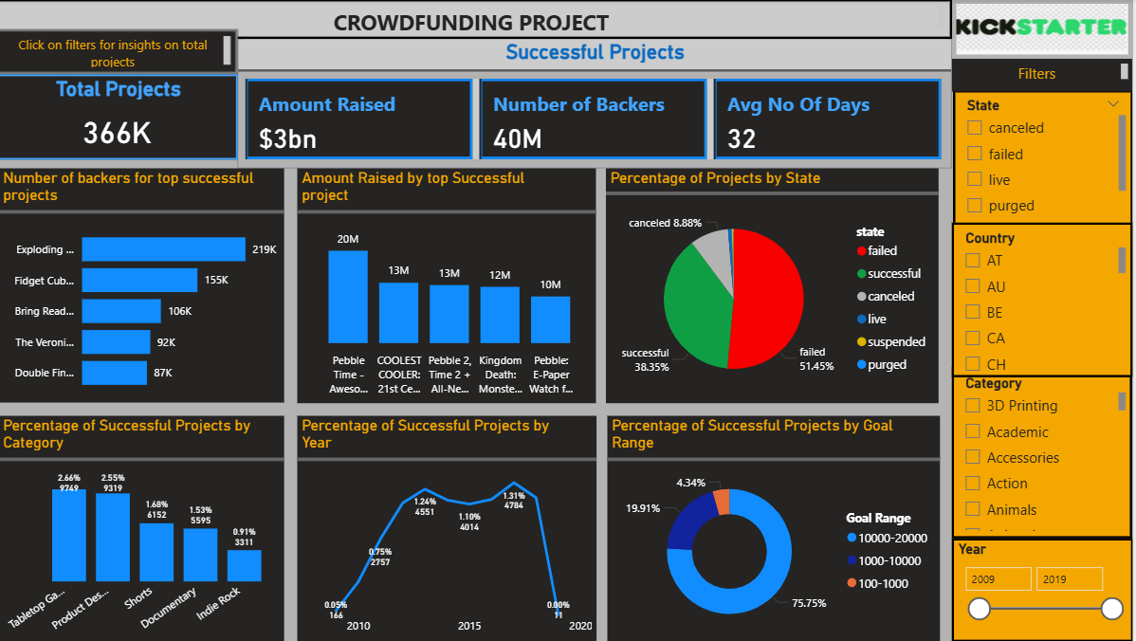
How did we encounter those challenges in Creating Power BI Report
Using ChatGPT is a great help as there are multiple in-built function.
Dashboard

Slide 7
Challenges while creating Dashboard in Tableau
When you import data from into tableau, drag it into data model, due to change in names, connection is not done properly(one column needs to be same for proper merging)
Major Challenge faced by us is in formatting i.e. background Color, how to remove gridlines
In Dashboards, you won’t find an option for slicer or timeline, that is little confusing for us from where to put slicers and timeline?

Slide 8
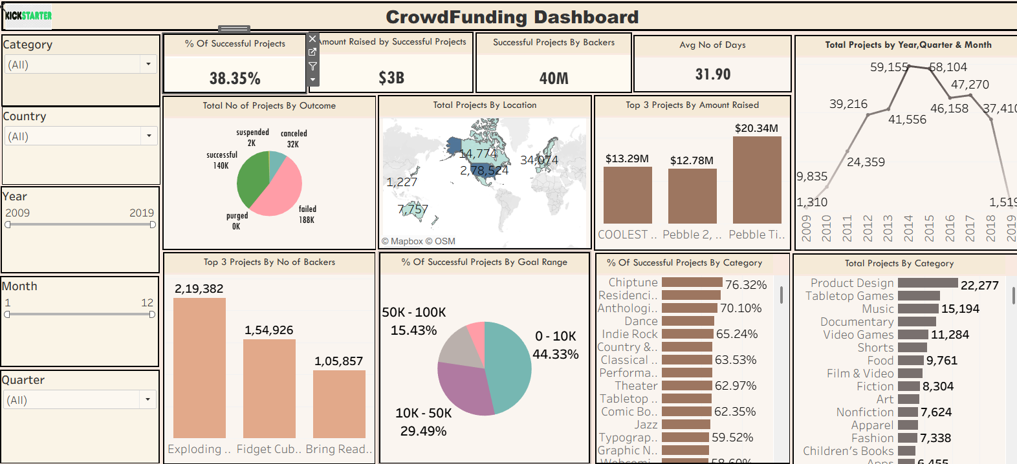
How did we encounter those challenges in Creating Tableau Dashboard
When loading data, always remember to change column names properly so it will be easy to connect the tables properly
Dashboard

Slide 9
My SQL
MySQL is not used for visualizations.
Using DQL Commands, we publish data using joins, Group by, CTE.
We also used MySQL for loading data in power BI.
These are some of the SQL Commands with Joins, CTEs and group by and order by

Slide 10


